Slide 1

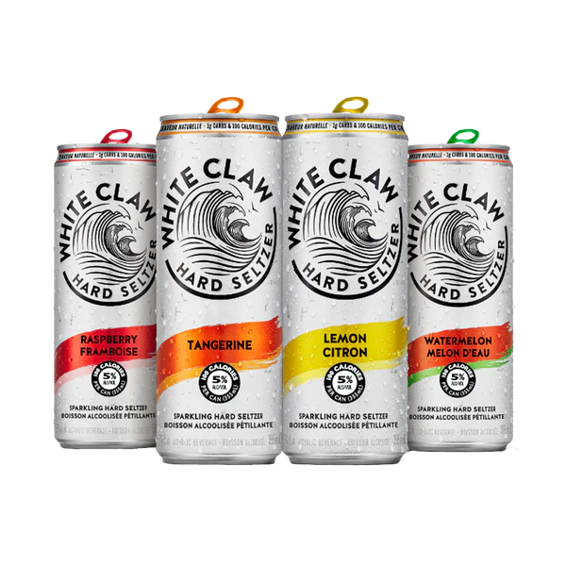





MRK803 - IMC
Assignment
Alister Almeida: 162857239
Nicole Pattathu: 163059231
Devansh Solanki: 142127224
Ishan Purohit: 168912236
Muskan 107182248

Slide 2


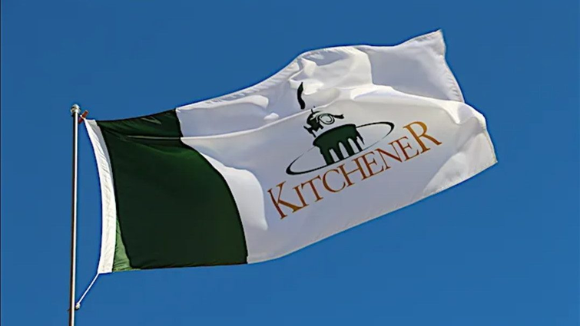
KITCHENER
Population Growth: There is a new population moving into the area, especially because of the expansion of the tech industry and immigration.
Housing Market Stability: The average price for a home in Kitchener-Waterloo was $800,087 as of May 2024, down slightly, –0.8%, month over month, but stable overall.
Buyer's Market: Even with price stability, it's still a buyer's market as sales-to-new-listings ratio indicates balanced market conditions.
Kitchener has a relatively young population, with a median age of 38.9 years. This demographic aligns very well with White Claw's target demographic of Caucasians between the ages of 21-44 from affluent neighborhoods. Like many urban centers, the residents of Kitchener tend to be health-conscious.
Kitchener urban residents will most likely appreciate convenient, portable drinks fit for any social occasion. Kitchener has experienced economic growth, which indicates disposable income for specialty drinks.
New residents are moving into the area as the tech industry expands. The Kitchener-Waterloo market presents opportunities for White Claw Zero Alcohol Seltzer, as the product is in line with health-conscious trends and also aligns with urban lifestyle preferences, along with its economic stability.

Slide 3

WHITE CLAW’S CURRENT STANDING
White Claw is a brand name synonymous with modern lifestyle aspirations of "guilt-free enjoyment." The brand uses its clean ingredients, sleek packaging, and association with leisure activities to speak to consumers desiring a more balanced indulgence.
This "lifestyle brand" appeal makes it different, classifying it in the beverage space as one for shared, memorable experiences rather than just a choice of drink​.
“Summer of White Claw” when Trevor Wallace posted a YouTube video that has since had 6 million views. The drink, about which many memes have since been made, “struck a chord with the spirit of American drinkers as it sits at the intersection of health, wellness and convenience”. In 2021, White Claw sales topped about $2 billion. The company still holds the title of “best hard seltzer.”
KEY FACTS
Expanded into Canada in 2020.
Launched non-alcoholic seltzers in December 2023.
Dominates hard seltzer market with around 45% share
Products are low in calories (70-100 per serving), low in carbs and gluten-free.
Purified carbonated water, alcohol, natural flavors, natural cane sugar, citric acid, and sodium citrate.
"Grab life by the claw." This catchphrase evokes a lighthearted, adventurous attitude.

Slide 4
PRIMARY RESEARCH
White Claw is the market share leader in the hard seltzer category at mid-50% globally and has remained flat despite increased competition.
White Claw has sold 16 million cases in 2023, outpacing the combination of over 350 other brands in the hard seltzer category. That speaks to its ability to hold onto leadership even as the market faces pressures.
It also focuses on its household penetration, making it a preferred choice to the health-conscious Millennials and Gen Z.
Strong brand equity coupled with focused digital campaigns give it that competitive edge and appeal across genders and age demographics.
Innovations like exotic flavors and "functional" benefits are in line with current consumer trends. The company tapped into its Internet fans and chose these flavors based on 70,000 social media requests. Listening to the preferences of your fans who reach out to you can go a long way.
White Claw has a search volume of 1,330,000,000 in Google, 42 times the search volume of "spiked seltzer" (2,530,000 results) and "hard seltzer" (28,900,000 results) combined.

Slide 5
SECONDARY RESEARCH
SEEDLIP | Premium appeal, mixology-focused. | Niche audience, limited scalability. | Growing 67.7% annually (small base).
Budweiser Zero | Strong branding, zero sugar/calories. | Confusion about malt base, aging appeal. | Declining share in non-alcoholic beer.
Heineken 0.0 | Traditional beer experience, broad base. | Limited to traditional marketing. | 9% global growth in 2022.
The global non-alcoholic wine and beer market is expected to reach USD 42.37 billion by 2032, growing at a CAGR of 6.47%.
Rising health consciousness among consumers is driving growth, particularly among millennials seeking healthier alternatives.
Social attitudes toward drinking are evolving, with more consumers embracing moderation or abstaining from alcohol altogether.
The hard seltzer market, currently worth about $13.47 billion, could grow to $57.34 billion by 2030 according to Grand View Research.
The global market for Ready-to-Drink (RTD) beverages is expected to reach $17.67 billion by 2025, growing at a CAGR of 7.2% from 2018 to 2025.

Slide 6
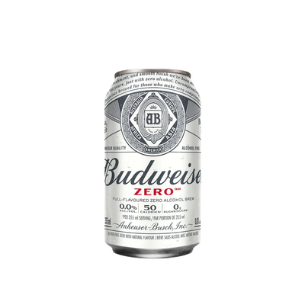
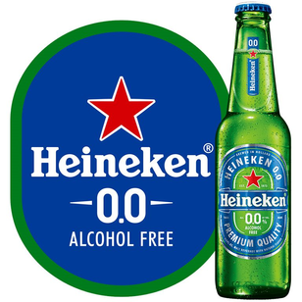
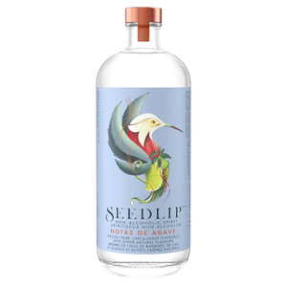

COMPETITORS
BUDWEISER ZERO
HEINEKKEN 0.0
SEEDLIP

Slide 7
OUR KEY OBJECTIVES AND WHAT WE EXPECT FROM IT...
Position White Claw Zero as a premium, health-conscious, socially inclusive non-alcoholic beverage brand.
Create a strategic foothold in top retail and on-premise accounts, including grocery stores, bars, and restaurants, with a focus on Millennials and Gen Z.
Build a strong local media and event presence which highlights the functional benefits of White Claw (e.g., low calories, hydration) and its lifestyle appeal.
Reach health-oriented consumers with digital campaigns and partnerships with influencers. Gain market share in soft drinks.
Compete directly with the likes of Heineken 0.0, Budweiser Zero, and Seedlip through innovative flavor, lower calories, and strong branding. Create repeat business through loyalty programs and promotional offers
Get recognition by 70% of Millennials and Gen Z within six months by running focused campaigns across all social media platforms.
Partner with 20 local retailers and on-premise locations such as bars and cafes
Host or sponsor three community events (summer festivals, fitness pop-ups, etc.) to create a physical presence
Deliver $500,000 in sales revenue from Kitchener in its first 12 months, complementing Canada's $199 million non-alcoholic market.
Capture 10% market share of the non-alcoholic category in Kitchener by the end of the first year, rivaling competitors like Heineken 0.0 and Budweiser zero
Convert 25% of trial customers into repeat buyers using targeted retargeting campaigns and loyalty points integration with enticing bundle offers.
Attract 1,000 participants per event for three localized events, achieving high visibility through photo booths, giveaways, and sampling​.
Collect 500 responses from each event to gather actionable insights into consumer preferences and tailor future campaigns.

Slide 8

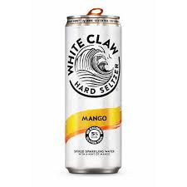
Target Market
Demographics
Psychographics
Media habits
Age: 21 to 45 years with primary focus on 21-34 segment.
Gender: Balanced across genders
Income: Middle to upper middle class with a household income of around $75,000.
•Ethnicity: Predominantly Caucasian, but multicultural trends observed
Lifestyle: Health-conscious, socially active, and eco-conscious individuals.
Health focused, socially active, and sustainable conscious consumers.
Interests: Fitness, wellness, and social gatherings.
Values: Guilt-free indulgence, balance, and modern lifestyles.
* Aligns with White Claw's emphasis on wellness and social interactions.
Digital Platforms:
Instagram, TikTok, and Facebook dominate due to high engagement and high audience interaction.
Younger generation is more inclined towards Spotify and Youtube.
Traditional Media:
Local radio stations like 91.5 The Beat and community events ensure wider, localized reach.
Local Influencers:
Wellness and Lifestyle influencers showcase brand authenticity and strong connection with target consumers.

Slide 9
Brand Positioning: White Claw Zero Alcohol Seltzer
For customers who value health and active lifestyles while looking for savory and sociable experiences, White Claw Zero Alcohol Seltzer delivers a distinctive blend of guilt-free enjoyment, contemporary branding, and inclusive appeal.
White Claw meets the increasing demand for wellness-focused, non-alcoholic beverages that complement a balanced lifestyle by sticking to its famous low-calorie, gluten-free formula.
Value proposition
White Claw Zero Alcohol Seltzer is the go-to premium non-alcoholic beverage for socially engaged, health-conscious young adults in Kitchener because it combines natural ingredients with contemporary, inclusive branding to deliver refreshing flavors and wellness-inspired enjoyment.
The company distinguishes itself as a lifestyle enabler by providing a beverage that goes well with social events, exercise regimens, and guilt-free enjoyment.
Positioning Statement
White Claw prioritizes innovation and lifestyle integration over typical non-alcoholic beer experiences, in contrast to rivals like Heineken 0.0 and Budweiser Zero.
The product appeals to its target market because of its unique flavors (such mango passionfruit and black cherry) and health-conscious positioning (low calorie and gluten-free).
White Claw's branding, which includes stylish packaging and slogans like "Grab Life by the Claw," elevates the beverage beyond a simple beverage to a social experience.
Key Diffrentiators

Slide 10
IMC PLAN OVERVIEW
Purpose of the IMC Plan:
Promote White Claw Zero Alcohol Seltzers in Kitchener and create a desire for the product.
This will help to promote product trials as well as brand loyalty among the health-conscious community that is also very active on social networks.
KEY COMPONENTS
Short-Term (First 3 Months): Short-Term : The following objectives should be achieved in the short run; establish brand awareness, create a buzz and encourage consumers to buy the product through influencer marketing, sampling and specific SM campaigns.
Long-Term (Next 3 Months): The focus should be on the sustained engagement with the brand and growth of the brand’s market share through events, collaborations and retargeting campaigns.

Slide 11
IMC SHORT TERM PLAN
(FIRST 3 MONTHS)
Objectives and Strategies for the First 3 Months:
Objective: Increase brand awareness in Kitchener and the consumers’ interest in the product thereby boosting the number of consumers who will try the product.
Strategy: The target audience is people who are concerned with their health and are active socially by using influencer to promote the product, sampling, and social media challenges that are focused on health and people's community.
White Claw then integrates the local fitness culture of Kitchener: They can be associated with local fitness events, outdoor sports, and community fitness events.

Slide 12
PUSH STRATEGIES
PULL STRATEGIES
1. Instagram & TikTok "Guilt-Free Challenge":
“Guilt-Free Challenge” on TikTok in which influencers and people record their workouts and their consumption of White Claw while having fun.
Encourage participation by offering them free products or gifts.
Platform: Instagram, TikTok
Goal: Generate trends and boost the brand’s recognition.
2. Geo-targeted Instagram and TikTok Ads:
Target people in Kitchener by showing them consuming White Claw while working out at well-known places such as Victoria Park or Kitchener-Waterloo events and give them a code to use the product for the first time.
Platform: Instagram, TikTok Ads
Goal: Targeted promotion of the product with a focus on local consumers.
1. Pop-Up Sampling Events:
Place sample stands at fitness clubs, health workshops, and food fairs and make these events more exciting by offering the White Claw Fitness Challenge which is taking fitness classes and getting rewarded with free products.
Goal: To design concrete Brand experiences that the consumer can feel to try out the product.
2. Influencer "Guilt-Free Moments":
Collaborate with local influencers (fitness trainers, yoga instructors) to document their post-workout enjoyment of White Claw.
Focus on the brand’s guilt-free, wellness appeal.
Platform: Instagram Stories, TikTok
Goal: Build authentic, hyper-local connections and trust with the target audience.

Slide 13
Pre-launch
activities
During launch
activities
Post launch
activities
Instagram Stories Countdown:
To increase users’ participation and to get them to subscribe, use exclusive giveaways.
Teaser Influencer Posts: Send out White Claw sample to the local wellness influencers and make them post a preview of the product (unboxing, sneak peak) prior to the event. This is to create a hype and create anticipation from the audience on their social networks.
Interactive Instagram Polls & Contests:
Get the users involved by making them choose between different flavors that may be offered at the sampling events or how they would most prefer to take their White Claw. Organize a competition for tickets to exclusive fitness events or a private White Claw tasting session for free.
Goal: The target is to increase participation and reach out to more people.
Influencer “Takeovers” at Wellness Events: Have influencers manage the Instagram or TikTok accounts of local gyms, yoga studios, and community events to share the real-time experiences of the consumers consuming White Claw during fitness activities.
Goal: To enhance the brand awareness in real time and to make the brand more relatable.
Customer Reviews & Social Sharing:
After launch, encourage the consumers to use the product and post their experience with the hashtag #GuiltFreeIndulgence on their Instagram or TikTok accounts. To this end, give a discount of 10% off or give them access to new flavors for the best posts.
Email Campaign:
Send a thank you email to all the attendees with a coupon that gives them 15% off their next purchase to try the product again in the future.

Slide 14
IMC LONG TERM PLAN
(NEXT 3 MONTHS)
Objectives and Strategies for the Next 3 Months:
Objective: To build brand awareness and loyalty and to increase the market share of the brand in Kitchener.
Strategy: To sustain the engagement, one has to look for ways of engaging the consumer more through sponsoring, influencer, and event marketing.
Focus on retargeting the users who have engaged with the brand and on keeping the product and its presence strong in Kitchener through partnerships with local businesses and events.

Slide 15
Sustained Engagement Activities
Action 1: Kitchener Market Wellness Events Sponsorship
To continually target the health-focused consumers, organize and sponsor wellness workshops, fitness classes and community fitness events in Kitchener. Give out wellness-branded materials at these events including yoga mats, and water bottles so that White Claw is easily remembered.
Action 2: Co-branded events in collaboration with Local Fitness Brands
The following are some of the ideas that can be used in co-branded events with local fitness centers, wellness studios, and health brands such as pop-up fitness classes, post-yoga brunches or White Claw fitness challenges.
Action 3: Retargeting Campaigns
To get to the consumers who have previously engaged with the campaign and have not made a purchase, one has to use retargeting ads on Instagram and TikTok. Create exclusive offers or just remind them of the benefits of purchasing the product with the help of the ads that will show to consumers who have previously visited the store. Offer exclusive deals or remind them of the benefits of White Claw through creative content.

Slide 16

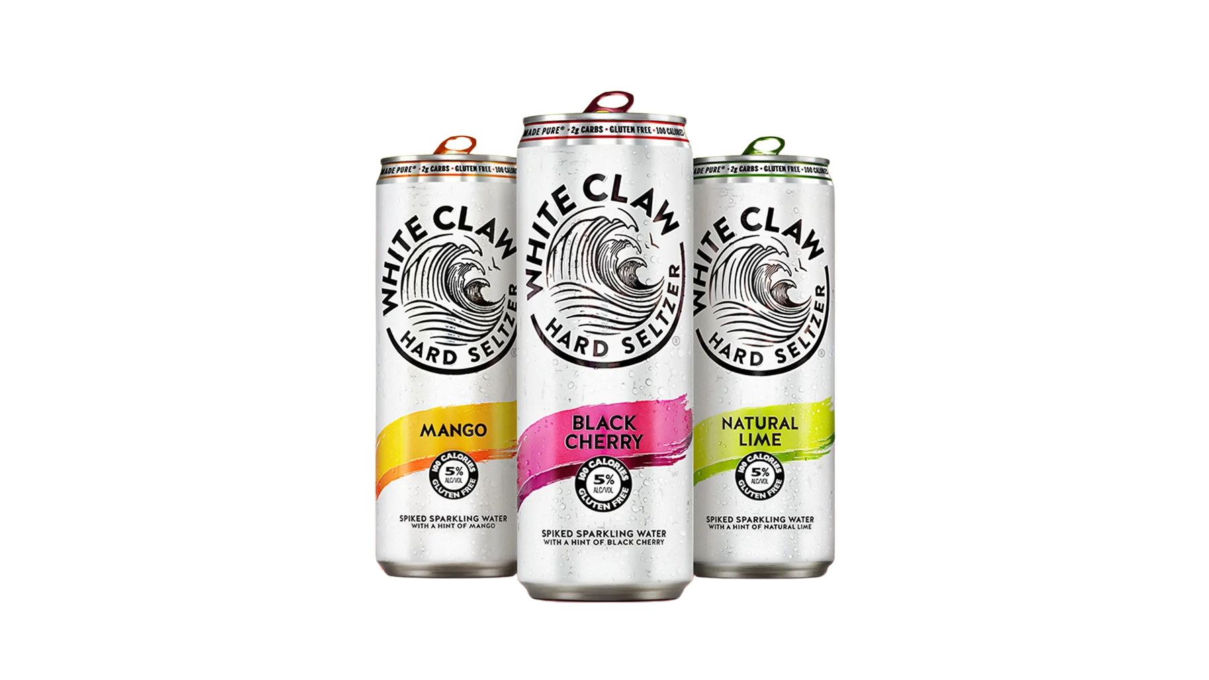

College Brand Ambassadors:
Media Plan
Recruit socially active students from Kitchener colleges, such as Conestoga College.
Activities:
Social media promotions (Instagram, TikTok) with hashtags like #GrabLifeByTheClaw.
Sampling events on campus with free drinks and QR codes for discounts.
Ambassadors sharing personalized discount codes with peers.
Rationale:
College ambassadors are trusted by their peers and foster authentic connections with the target demographic (Platform Magazine, 2024). Referral marketing via ambassadors can boost conversion rates by 5–25% (Social Ladder, 2024).
Sponsorships at College Fests and Events:
Sponsor popular college events such as cultural fests, sports meets, and wellness fairs.
Activities:
Sampling booths offering free drinks.
Photo booths with branded props for social media sharing.
Fitness challenges with prizes, such as branded merchandise.
Rationale:
Event sponsorships build brand awareness and engagement, leading to stronger brand loyalty (Springer, 2024). High exposure during events enhances visibility (Go Dreamcast, 2024).

Slide 17
Geo-Targeted Digital Campaigns:
Platforms: Instagram, TikTok, Spotify.
Activities:
Targeted ads showing White Claw Zero in local settings (e.g., fitness events, college hangouts).
Influencer partnerships creating content on TikTok and Instagram.
Rationale:
Digital platforms like Instagram and TikTok are critical for engaging young audiences (The Campus Agency, 2024). Influencers build trust and credibility among health-conscious consumers (Social Ladder, 2024).
Media Plan
Local Radio Ads:
Partner with stations like 91.5 The Beat to promote events and wellness tips paired with brand messaging.
Rationale:
Local radio offers targeted reach to specific demographics, complementing digital efforts (Go Dreamcast, 2024).
Sampling Events at Fitness Centers:
Host sampling events at gyms and yoga studios in Kitchener.
Activities:
Free drink distribution during fitness classes.
Hydration stations branded with White Claw logos.
Rationale:
Sampling creates memorable brand experiences, fostering loyalty and encouraging trial (CORE, 2024).

Slide 18


Budget Break-Up
Category | Budget | Percentage
College Brand Ambassadors | $125,000 | 16.7%
College Fest Sponsorships | $150,000 | 20.0%
Geo-Targeted Digital Campaigns | $200,000 | 26.7%
Local Radio Ads | $75,000 | 10.0%
Sampling Events | $75,000 | 10.0%
Creative/Contingency | $25,000 | 3.3%
Total | $750,000 | 100%

Slide 19
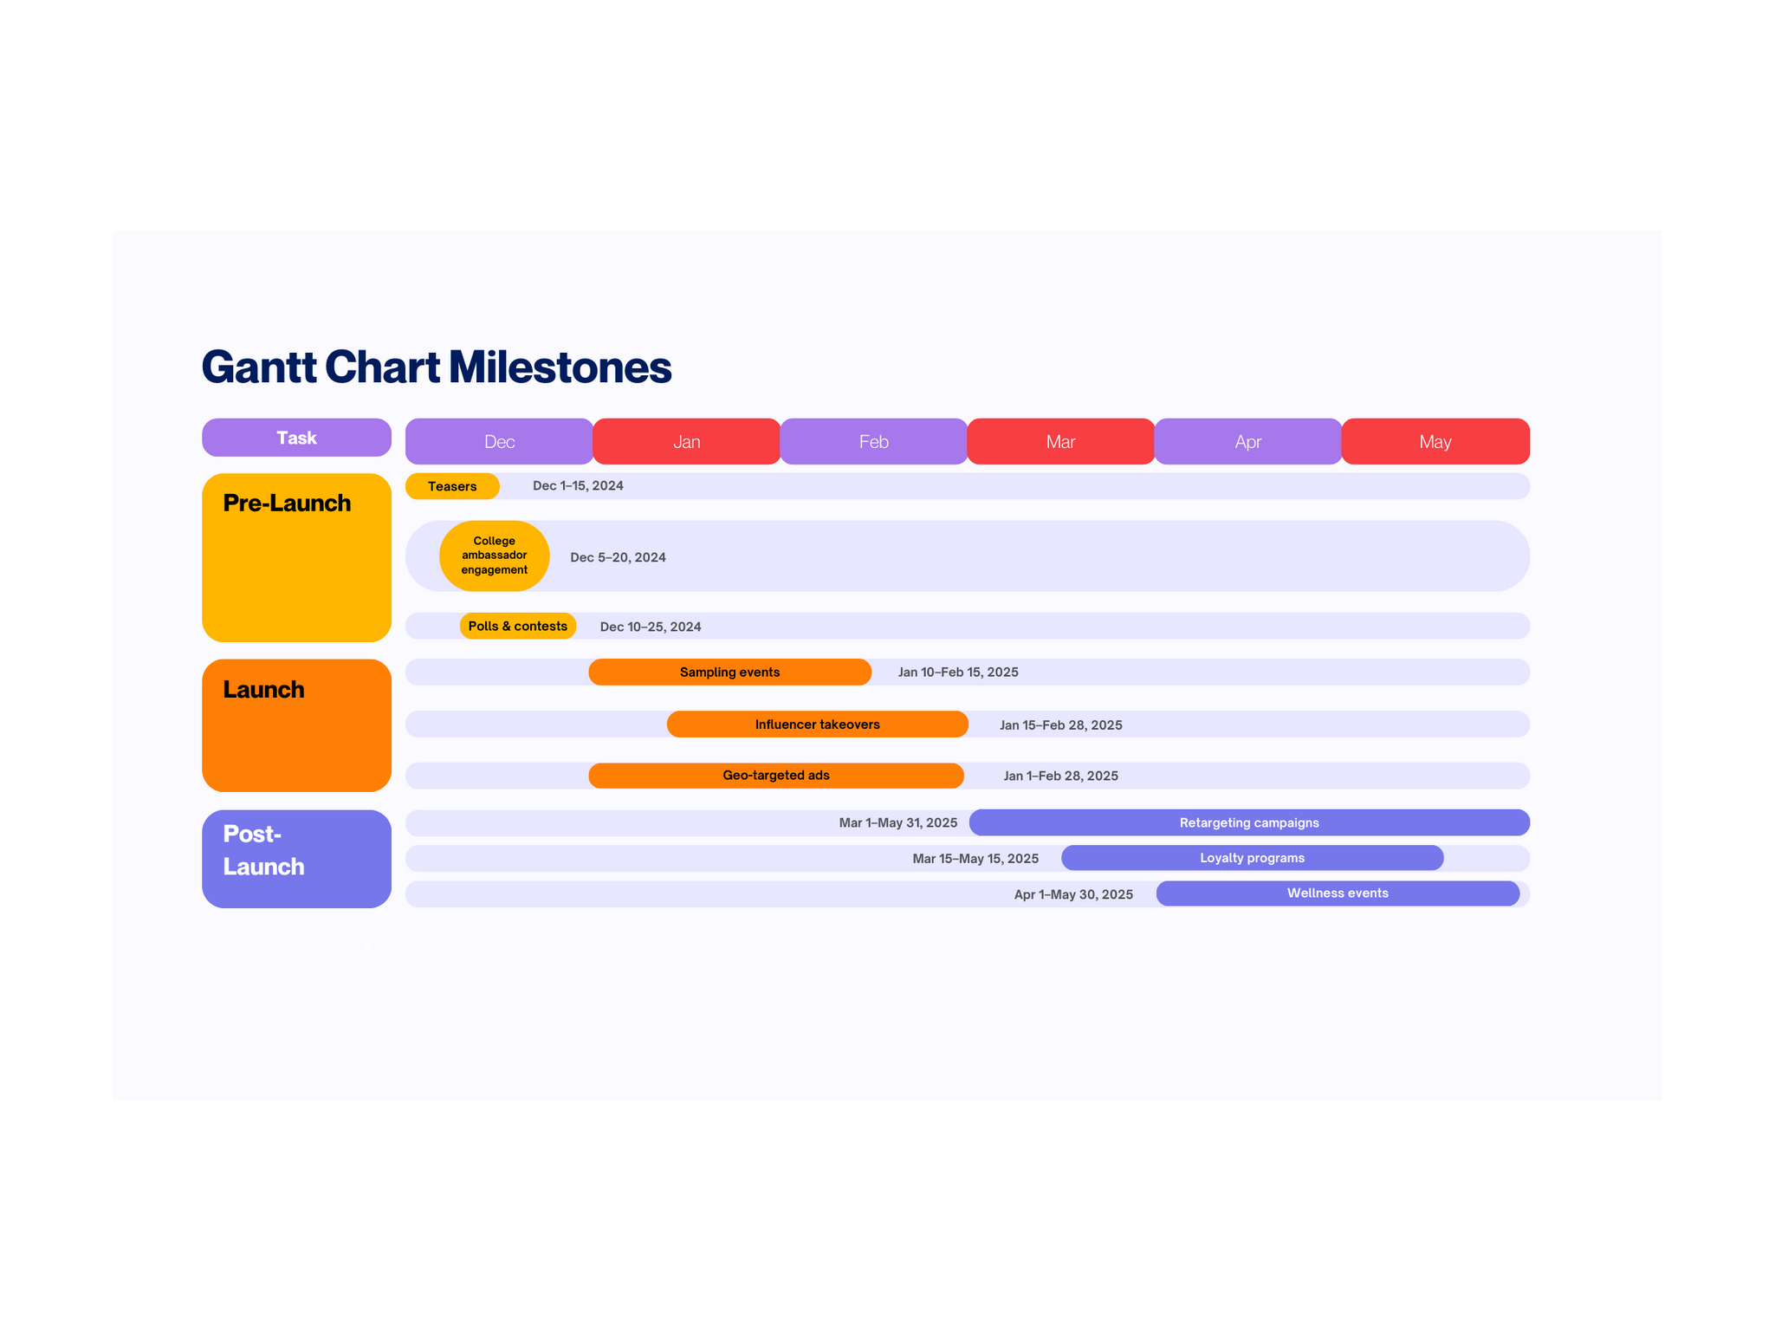
Implementation Timeline

Slide 20
Metrics and Measurement Overview
Digital Campaign Performance
KPIs:
Engagement Rate: >5% on Instagram and TikTok.
Click-Through Rate (CTR): >2%.
Reach: 200,000 impressions per platform.
Tracking Tools:
Hootsuite for engagement and growth.
Google Ads Manager for CTR and impressions.
TikTok Analytics for influencer content performance.
Event Success Metrics
KPIs:
Attendance: >1,000 participants per event.
Product Trial Rate: 50% of attendees trying the product.
Feedback: 80% of attendees complete surveys.
Tracking Tools:
Eventbrite for registrations.
Google Forms for survey feedback.
Revenue and Market Share Goals
KPIs:
Revenue Target: $500,000 in sales within 12 months.
Market Share: 10% of the non-alcoholic beverage market in Kitchener.
Tracking Tools:
POS Systems for real-time sales tracking.
Salesforce/HubSpot for detailed sales reporting.
Customer Retention
KPIs:
Retention Rate: 25% of trial customers become repeat buyers.
Loyalty Program Signups: 10,000 customers in 3 months.
Tracking Tools:
Mailchimp for loyalty program engagement.
CRM Software for repeat purchase analysis.

Slide 21
Strategic Partnerships and Cause Marketing Initiatives
Cause Marketing:
Sustainability Initiatives:
Eco-friendly packaging with QR codes for awareness.
Community clean-up drives with free samples.
Carbon footprint offset programs.
Health Collaborations:
30-day fitness challenges with branded rewards.
Hydration zones at fitness events.
Local Collaborations:
Events:
Sponsor college fests (Conestoga College) and wellness expos.
Host hydration stations and sampling booths.
Strategic Partnerships:
Partner with GoodLife Fitness for fitness events.
Collaborate with health-focused influencers and local cafes.

Slide 22
Benefits of Partnerships and Initiatives
Consumer Connection:
Foster trust with eco-conscious and health-focused consumers.
Build authentic engagement through local events and ambassadors.
Community Engagement:
Strengthen White Claw’s local presence in Kitchener.
Drive trial and loyalty through collaborations with trusted local organizations.
Brand Differentiation:
Showcase White Claw’s commitment to health and sustainability.

Slide 23

Recap of Strategies
Market Understanding:
Target audience: Health-conscious Millennials and Gen Z in Kitchener.
Strong alignment with local fitness and wellness trends.
Key IMC Components:
Short-Term: Brand awareness through influencer campaigns, social media challenges, and sampling events.
Long-Term: Sustained engagement via wellness events, loyalty programs, and retargeting ads.
Media Plan Highlights:
Integrated use of Instagram, TikTok, local radio, and on-ground activations.
Geo-targeted campaigns and college ambassador programs to enhance reach and engagement.

Slide 24

RECOMMENDATIONS
Short-Term Action Points:
Launch interactive campaigns on TikTok and Instagram with fitness influencers.
Host pop-up sampling events to promote trial and build awareness.
Leverage college ambassadors to connect authentically with the target demographic.
Long-Term Action Points:
Partner with local wellness organizations and gyms for co-branded events.
Build customer loyalty through retargeting campaigns and exclusive offers.
Maintain engagement with cause marketing efforts like clean-up drives and eco-friendly packaging promotion.
Measurable Goals:
Achieve $500,000 in sales revenue and capture 10% market share within 12 months.
Convert 25% of trial customers into repeat buyers through loyalty programs.

Slide 25

Why White Claw Zero Will Succeed in Kitchener
"By aligning with Kitchener’s health-conscious and eco-friendly lifestyle, White Claw Zero Alcohol Seltzer will not only dominate the non-alcoholic beverage market but also set a standard for lifestyle branding in the region."
Thank You

